Slide 1
Lecture 6
Requirement Change Management
Muhammad Qasim
BSCS (Software Engineering-I) SZABIST-Islamabad

Slide 2
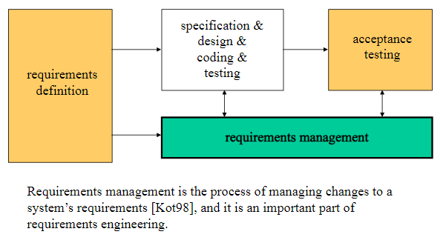
Introduction
BSCS (Software Engineering-I) SZABIST-Islamabad

Slide 3
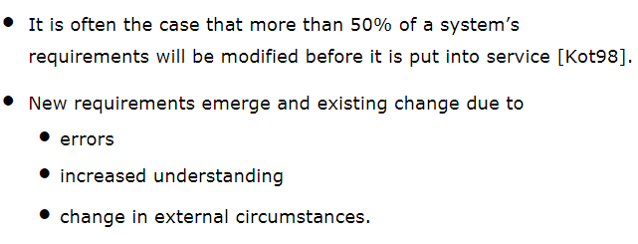
Introduction
BSCS (Software Engineering-I) SZABIST-Islamabad

Slide 4
Introduction
Changes to the requirements should be documented and controlled formally.
Change management process ensures that
  changes are made systematically
    similar information is collected for each proposed change
    overall analysis is made about the costs, benefits and timing
  the requirements document is updated.
BSCS (Software Engineering-I) SZABIST-Islamabad

Slide 5
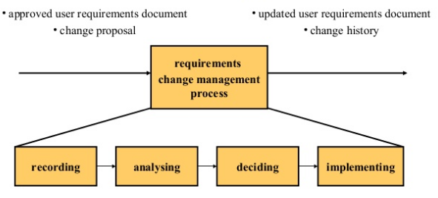
Requirement Change Management Process
BSCS (Software Engineering-I) SZABIST-Islamabad

Slide 6
Requirement Change Management Process
Recording a change Proposal:
Stakeholders submit proposals for requirements changes using a pre-defined form.
BSCS (Software Engineering-I) SZABIST-Islamabad

Slide 7
Requirement Change Management Process
Analyzing a change request:
The proposed change is analyzed to see
  if it is valid. Sometimes stakeholders misunderstand the requirements and suggest unnecessary changes.
  how many requirements and system components are affected
  how much it would cost, in both time and money, to make the change
  what the benefits of the change are.
BSCS (Software Engineering-I) SZABIST-Islamabad

Slide 8
Requirement Change Management Process
Deciding on a change request:
Change requests are considered formally by a group or a person who decide whether or not the change should be accepted.
BSCS (Software Engineering-I) SZABIST-Islamabad

Slide 9
Requirement Change Management Process
Implementing a change request:
Updating the requirements document.
Informing all the necessary people.
BSCS (Software Engineering-I) SZABIST-Islamabad

Slide 10
Traceability
Requirements traceability refers to the ability to describe and follow the life of a requirement, in both forwards and backwards direction (i.e., from its origins, through its development and specification, to its subsequent deployment and use, and through all periods of ongoing refinement and iteration in any of these phases)”
BSCS (Software Engineering-I) SZABIST-Islamabad

Slide 11
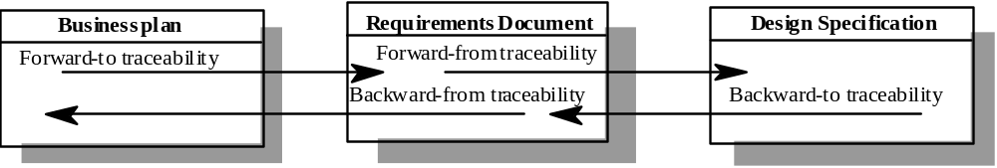
Backward and Forward Traceability
Backward traceability
  To previous stages of development
  Depends upon each element explicitly referencing its source in earlier documents
Forward traceability
  To all documents spawned by a document
  Depends upon each element in the document having a unique name or reference number
BSCS (Software Engineering-I) SZABIST-Islamabad

Slide 12
Traceability Types
Requirements – source traceability
  Links requirements with a person or document
Requirements – rationale traceability
Requirements – requirements traceability
  Links requirements with other requirements which are, in some way, dependent on them
Requirements – architecture traceability
  Links requirements with the subsystems where these requirements are implemented (particularly important where subsystems are being developed by different subcontractors)
Requirements – design traceability
  Links requirements with specific hardware or software components in the system which are used to implement the requirement
BSCS (Software Engineering-I) SZABIST-Islamabad

Slide 13
Traceability Types
Requirements – interface traceability
  Links requirements with the interfaces of external systems which are used in the provision of the requirements
Requirements – feature traceability
Requirements – tests traceability
  Links requirements with test cases verifying them (used to verify that the requirement is implemented)
Requirements – code traceability
  Generally not directly established, but can be inferred
BSCS (Software Engineering-I) SZABIST-Islamabad

Slide 14
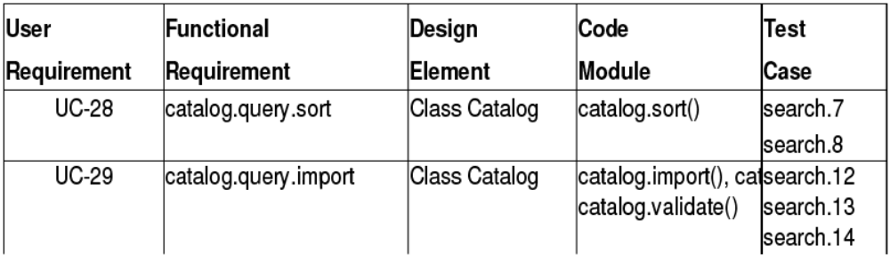
Representation – Traceability Table
Show the relationships between requirements or between requirements and other artifacts
Table can be set up to show links between several different elements
Backward and forward traceability
Difficult to capture different types of links
BSCS (Software Engineering-I) SZABIST-Islamabad

Slide 15
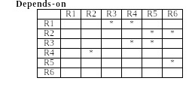
Representation – Traceability Matrix
Define links between pairs of elements
  E.g., requirements to requirement, use case to requirement, requirement to test case…
Can be used to defined relationships between pairs
  E.g., specifies/is specified by, depends on, is parent of, constrains…
More amenable to automation than traceability table
BSCS (Software Engineering-I) SZABIST-Islamabad

Slide 16
Traceability Goals - 1
Project Management
  Status: “When will we finish?” and “what will it cost?”
  Quality: “How close are we to our requirements?”
QA manager
  Improve Quality: “What can we do better?”
Change Management
  Versioning, documentation of changes (Why? What? When?)
  Change Impact analysis
Reuse
  Variants and product families
  Requirements can be targeted for reuse
BSCS (Software Engineering-I) SZABIST-Islamabad

Slide 17
Traceability Goals - 2
Validation
  finding and removing conflicts between requirements
  completeness of requirements
    derived requirements cover higher level requirements
    each requirement is covered by part of the product
Verification
  assure that all requirements are fulfilled
System Inspection
  identify alternatives and compromises
Certification/Audits
  proof of being compliant to standards
BSCS (Software Engineering-I) SZABIST-Islamabad

Slide 18
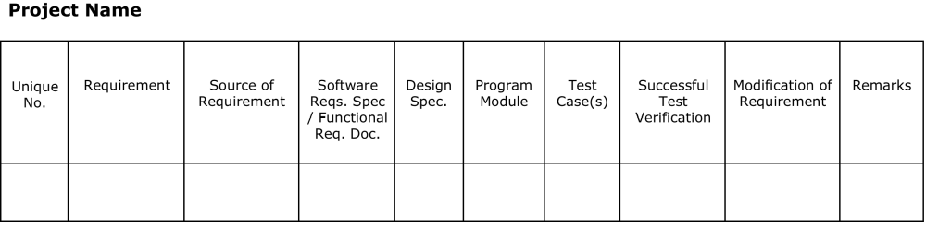
Traceability Documents
BSCS (Software Engineering-I) SZABIST-Islamabad

